Slide 1
2018.1 / 2019.1
What’s New in
Utility Management
Brian Badalucco – Product Owner
Steve Wheeler – Sr. Software Support Analyst

Slide 2
Agenda
What’s New - Release 2019.1
Q & A
Review - Release 2018.1
Notes:
Cover release 2018.1 as many of you not yet using it
Cover 2019.1 which comes out very soon

Slide 3
2018.1 Quick Review

Slide 4





2018.1 - Unibrow
No longer tied to IE
Works in ‘all’ 5 browsers
Chrome recommended
Notes:
IE is dying, we are no longer tied to it…we are off that sinking ship
And it’s nice to use the browser you like
We support IE, Edge, Chrome, Firefox and Safari
We recommend Chrome
Support for IE will sunset at some point.

Slide 5
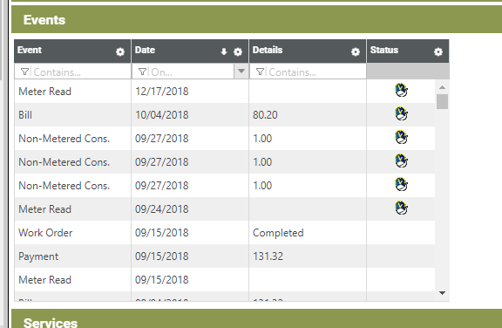
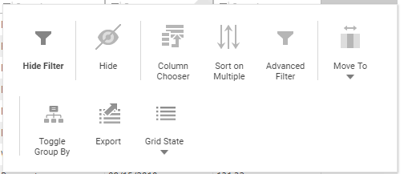
2018.1 – Grids
Highly configurable
  Show / hide columns
  Sort by any combination
  Group by
  Export
  Save your preferences
Notes:
Highly Configurable
(see list)

Slide 6
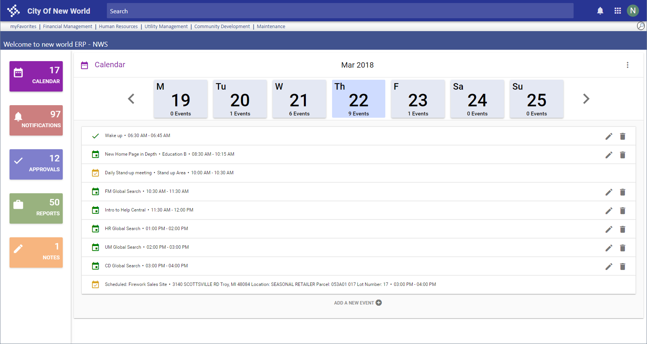
2018.1 – Home Page Re-imagined
Modern
Focused
Includes
  Calendar
  Reports
  Approvals
  Notes
Notes:
Modern look and feel – Nothing lost
Focused not cluttered. Pick an action and focus on that, with clarity
Areas
Calendar
Reports
Approvals
Notes

Slide 7
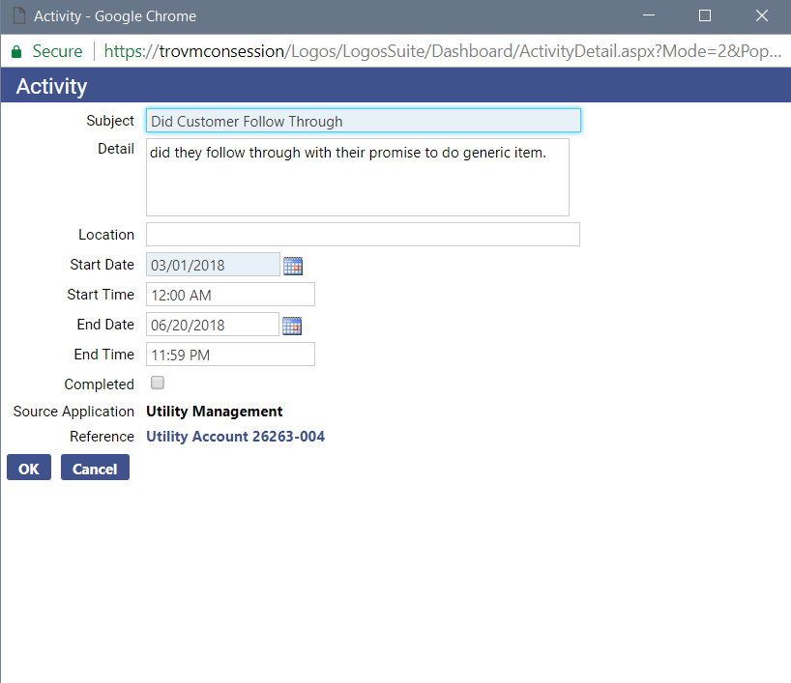
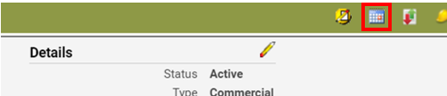
2018.1 – Home Page - Calendar
‘tickler file’ items go here – “electronic sticky notes”
Notes:
Calendar – Of interest to UM, tickler file actions go here – I call them Electronic sticky notes
Explain:
Create a future dated note to yourself from customer service or notes. “Create Activity”
shows in calendar on that date
has a link back into the account

Slide 8
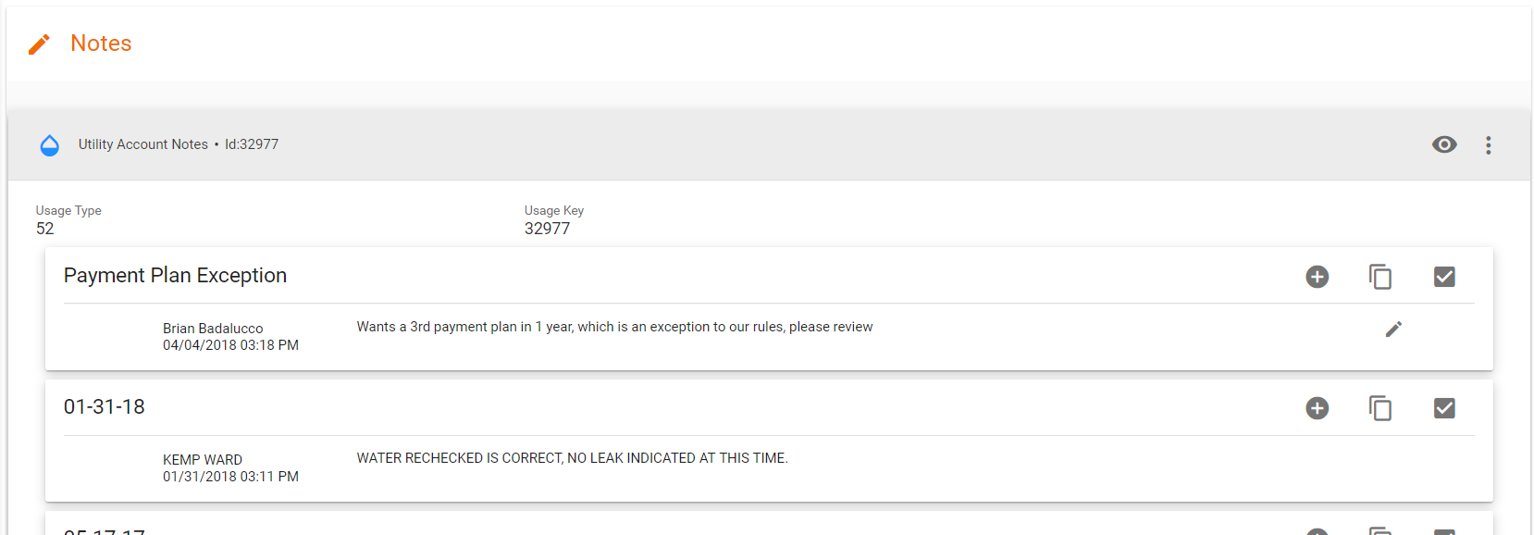

2018.1 – Home Page - Notes
New
Recent note & notes sent to you
Easily follow up
Notes:
Notes
New to home page
of interest to UM, as notes are a proxy for phone calls.
See your notes here and notes sent to you.
Easy to follow up
Create more notes right here
Eyeball icon takes you into customer service

Slide 9
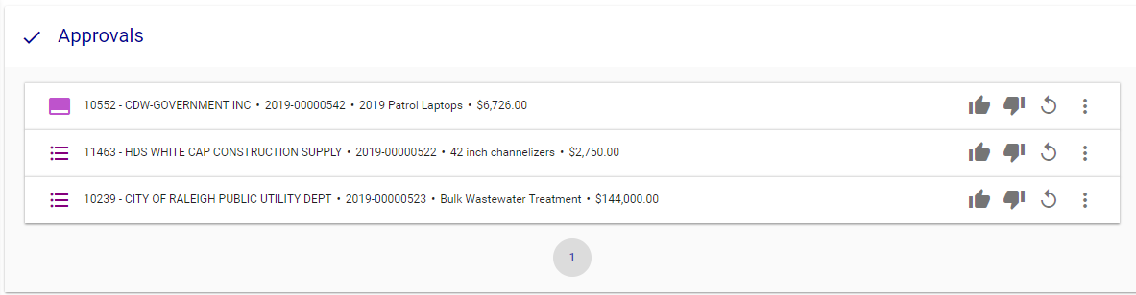
2018.1 – Home Page - Approvals
New
Centralized
Easily approve
Notes:
Approvals
New to home page
Central reminder location
Easy to follow up
Thumbs up and down to approve or not right here.

Slide 10
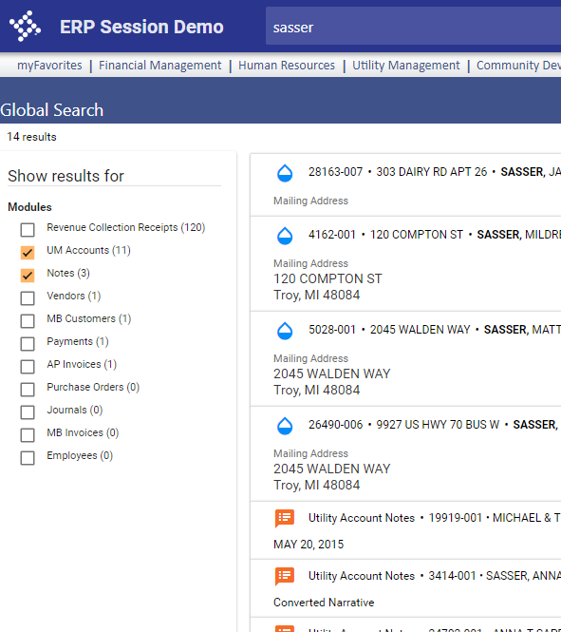
2018.1 – Global Search
Available everywhere
Searches everything
Notes:
Global search available from every page in NWERP
Searches ‘everything’
Gives you a big picture of who this account is across all your community
Includes Utility Accounts and Notes and Receipts
Searches on notes – calls or important notes.
Shortcut to Customer Service from anywhere

Slide 11
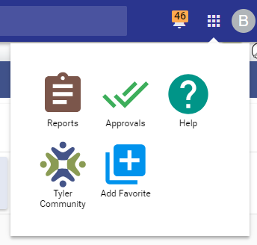

2018.1 - Help Central
Help Yourself
Notes:
From every screen you can get to help central.

Slide 12
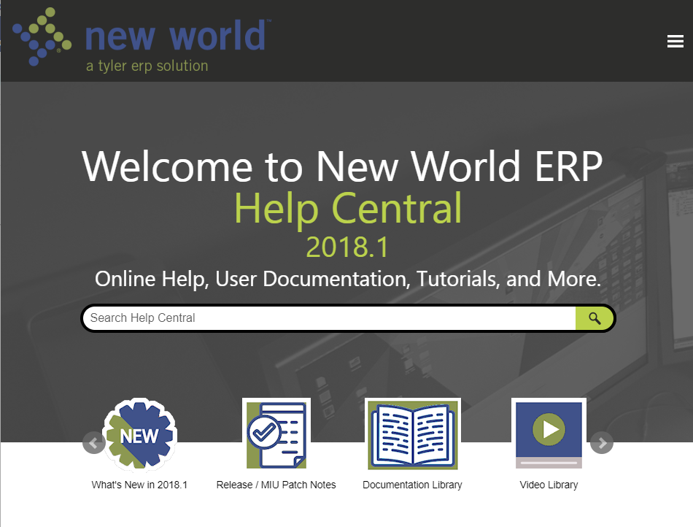
Help Central
Cloud Based
Search
Content Types
Notes:
Note the search bar
Cloud based means we can update it any time – always the most up to date info
Various content:
What’s new in the release
MIU patch notes
Full documentation
Videos!

Slide 13
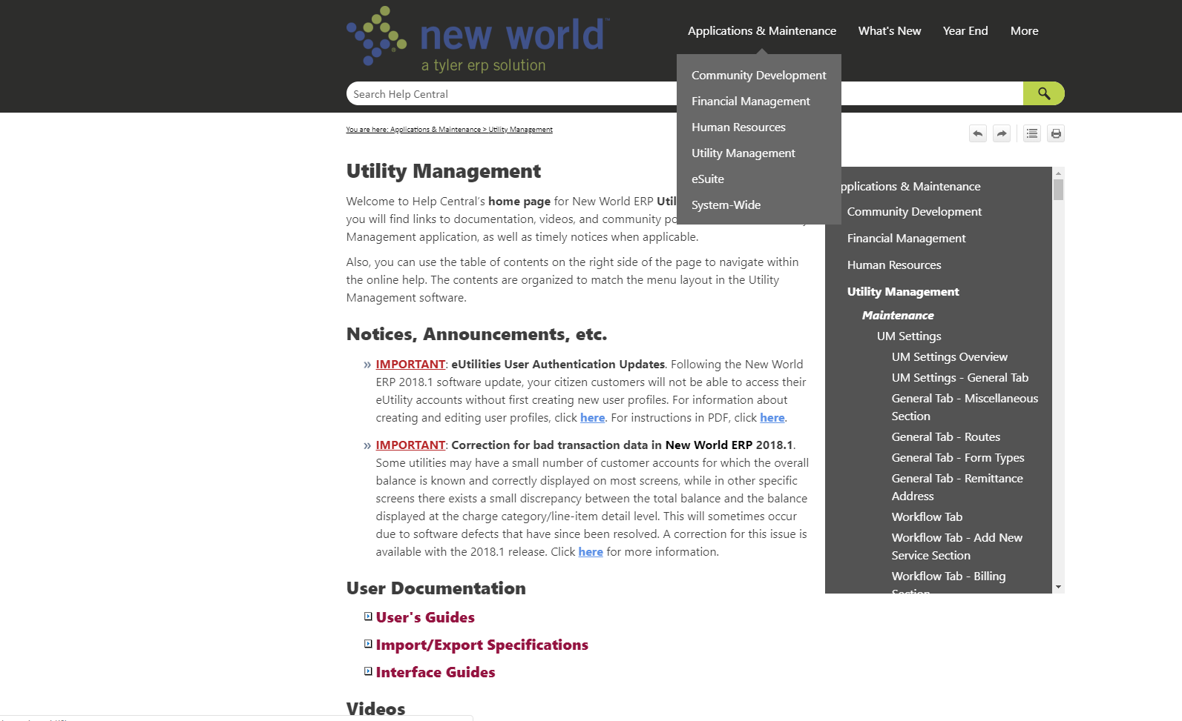
Help Central
Landing
Notes:
Application Specific Pages
Announcements
Application specific documentation

Slide 14

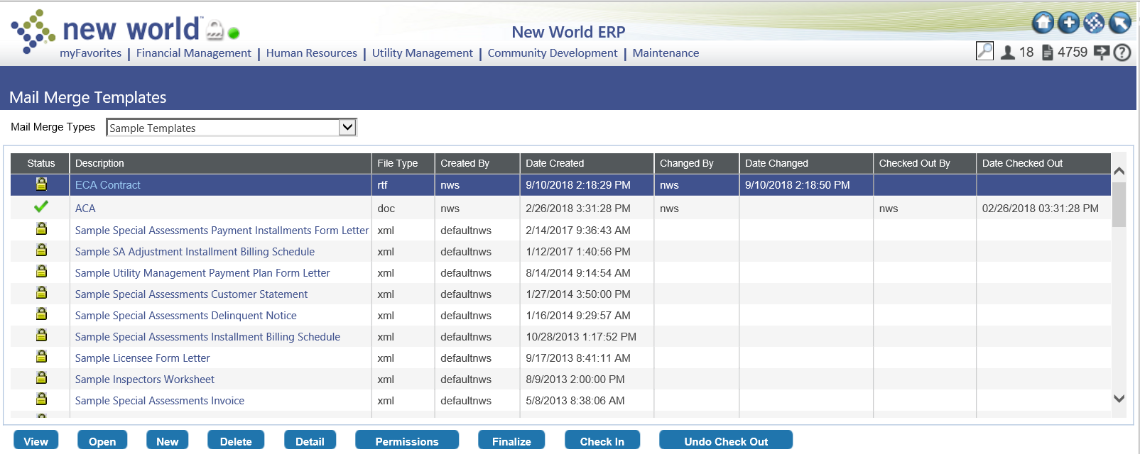
Mail Merge Templates - 2017.1

Slide 15
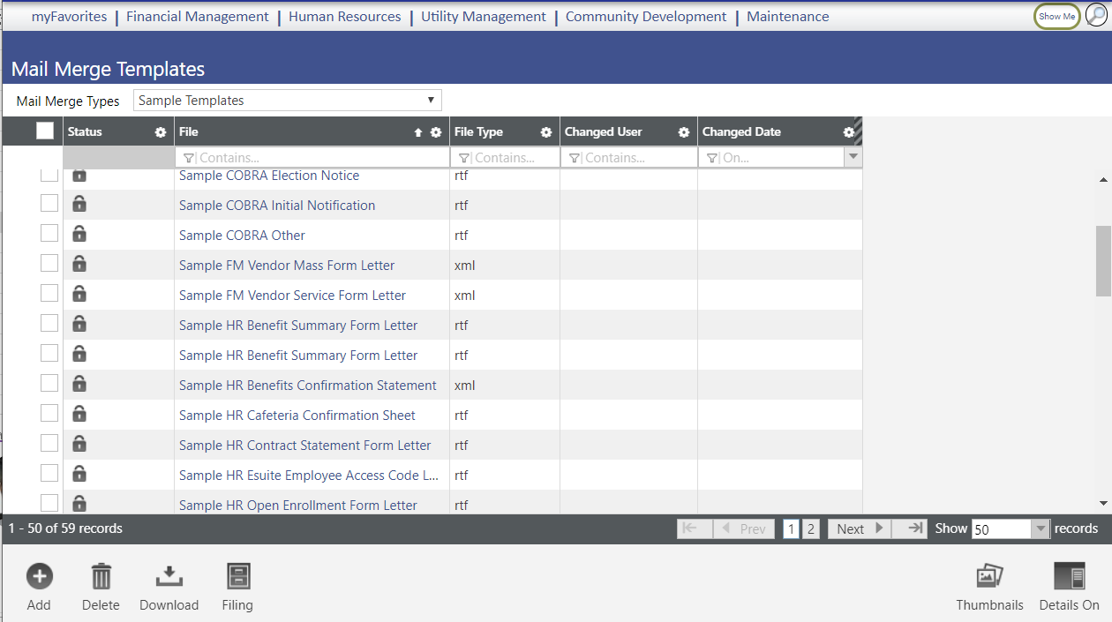
Mail Merge Templates - 2018.1 / 2019.1

Slide 16
eSuite - New Appearances & Functionality
User authentication: Username and Password
  New profile required
  Can be reset by the customer
Menu Bar: New design
Link to additional accounts (and delete):
  One user many accounts
  Many users one account
Customer Service Emulation: Advisor can see what the customer sees
Notes:
Summary

Slide 17
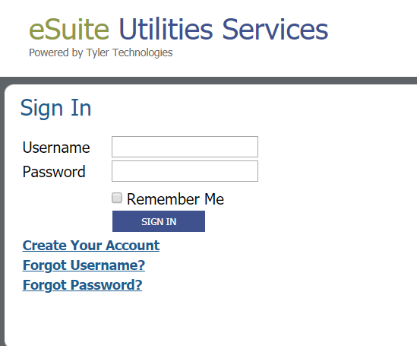
2018.1 - eSuite User Profiles
Standard
  User name and password
  Security measures
  ‘Forgot’ measures – customer controlled
Many to many
Notes:
Standard user Name and Password
First time actions: Prove you belong here / know you account, then create user name and profile
Supports many utility accounts on a user profile – my home, my parents home, my business
Supports many user profiles on an account, me, my roommates
Standard security measures
Verify your email address, password characteristics, password expiration, etc.
Standard Forgot measures
Username reminder email
Password reset email

Slide 18
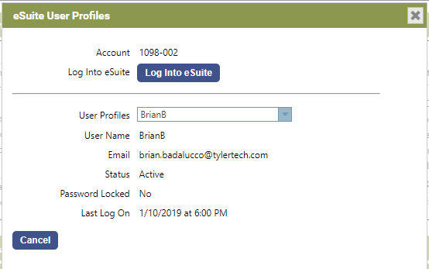
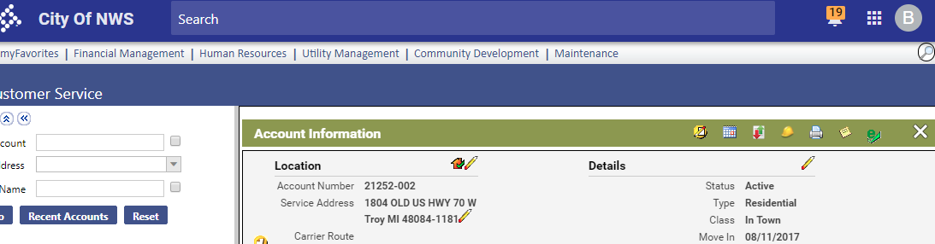


eSuite User Profiles
CSRs can see what the customer sees
Notes:
For those of you who want the CSRs to be able to get into esuite to see what the customer is seeing,
that is still available. They can not sign in anymore, but they can launch eSuite without signing in

Slide 19
eSuite User Profiles
Set up and rollout considerations
Permissions
Password parameters
Email templates
Notes:
Disrupt citizen experience the first time they visit after 2018.1
‘Standard Stuff’
But some customer may struggle
Also some security considerations (permissions) for CSRs
IT must determine password parameters – minimum length, etc.
Some outbound emails to configure
See webinars for details on setup and roll out.

Slide 20
Customer Service training considerations
Advisors need to understand new functionality:
  New Login procedure
  New screen appearance
  Ability to add multiple utility accounts to a user profile (and later, delete one or more)
  How to log in to a user’s account from Customer Service
Advisors need to be prepared to guide customers in:
  User ID and Password reset procedures
  Adding / deleting utility accounts to a user profile
**Preparation and Practice before upgrading is ESSENTIAL **
Notes:
Prepare! Be ready!

Slide 21
2019.1
Utility Enhancements

Slide 22
2019.1 Summary of Utility enhancements
Time stamp on receipts
Bad Debt export: SSN and birthdate added
Pending move outs flagged in Delinquent Processing
Account Notes enhancements
New Payment processor option: Open Edge
Transfer credit balance
Charitable Contributions – “Round-Up”
Notes:
Summary

Slide 23
Time Stamp Receipts
From the Idea Portal….
Be able to add a Time Stamp to the Utility Customer Receipts
Our Utility Cashiers would find it very useful to have a full Time Stamp on customer receipts. This would assist greatly with the cashiers' internal research and troubleshooting.
Notes:
It was a highly voted idea
Main story is receipt timing vs delinquent event timing.

Slide 24
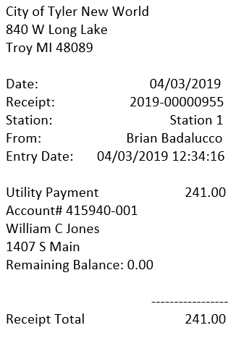
Time Stamp Receipts
On the physical receipt
  Slip printer – configurable
  Laser receipt - always
Notes:
The printed receipt has the time – the customer can see it, has a record of it
Full page receipt automatic
Slip printer needs to be configured

Slide 25
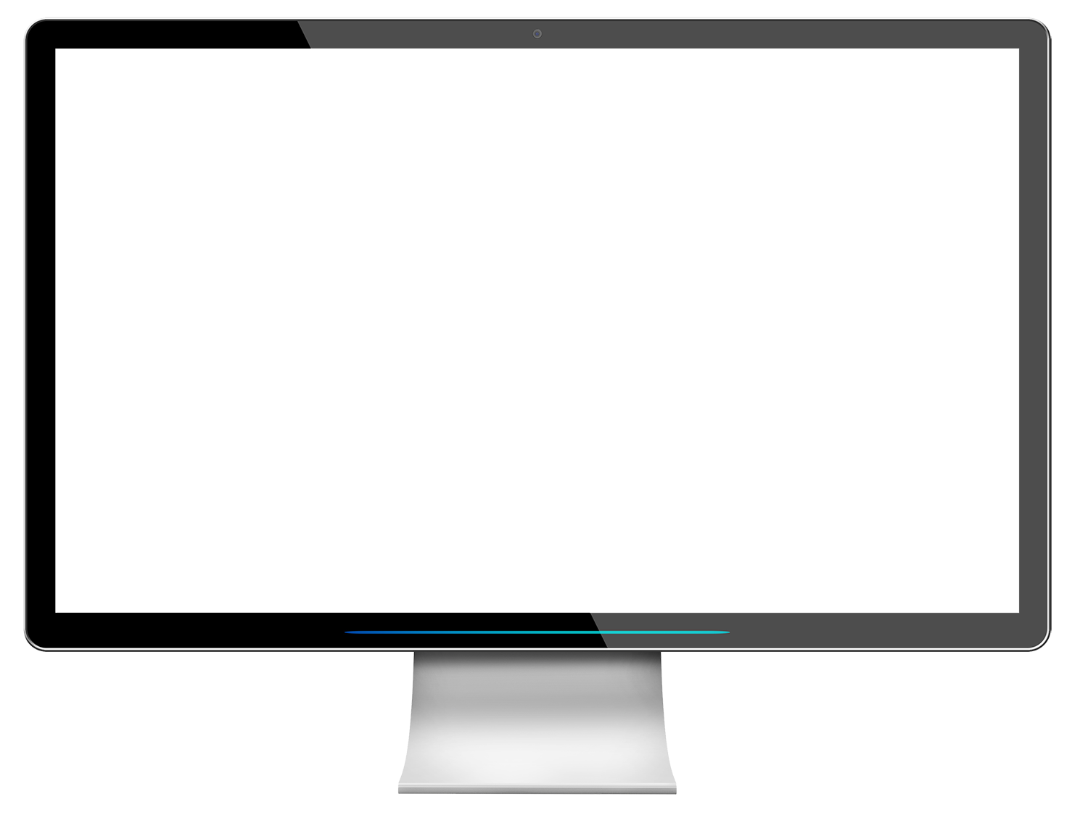
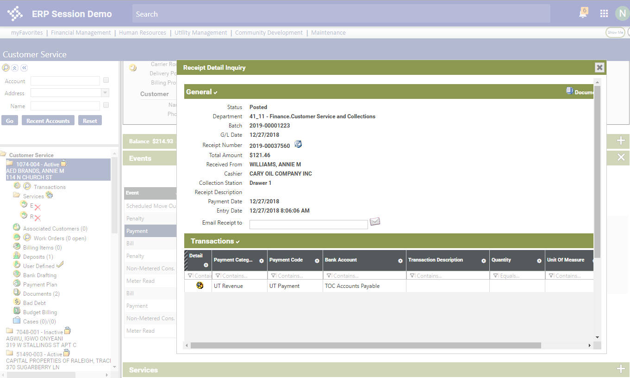
Notes:
Two Parts
Part one, exposing the payment time. When exactly, did the payment come in:
Receipt Inquiry Popup – so ‘everywhere’
You can see I got here through customer Service | Events
But available ‘everywhere’, for example receipt inquiry in FM also

Slide 26
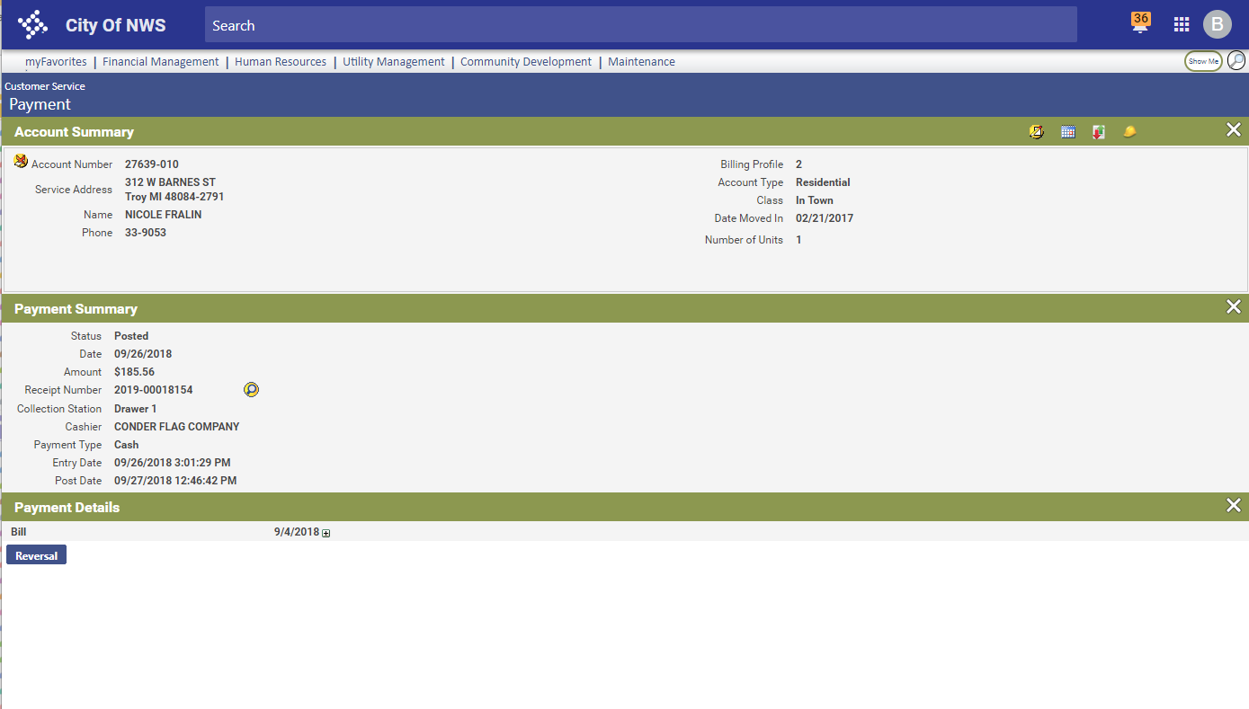
Notes:
Two Parts
Part one, exposing the payment time. When exactly did the payment come in:
Customer Service Transactions

Slide 27
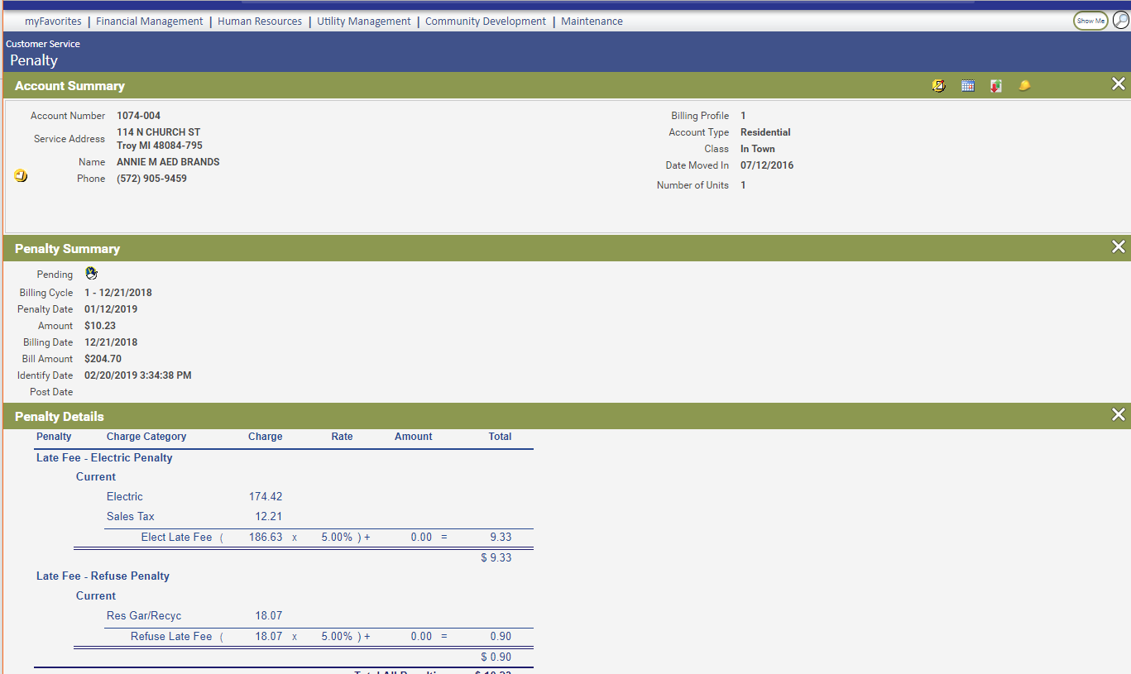

Notes:
Two Parts
Part two, exposing the delinquent event time, when exactly were delinquents processed (any delinquent, notices, penalties, shut off, etc.)
Customer Service Transactions.

Slide 28
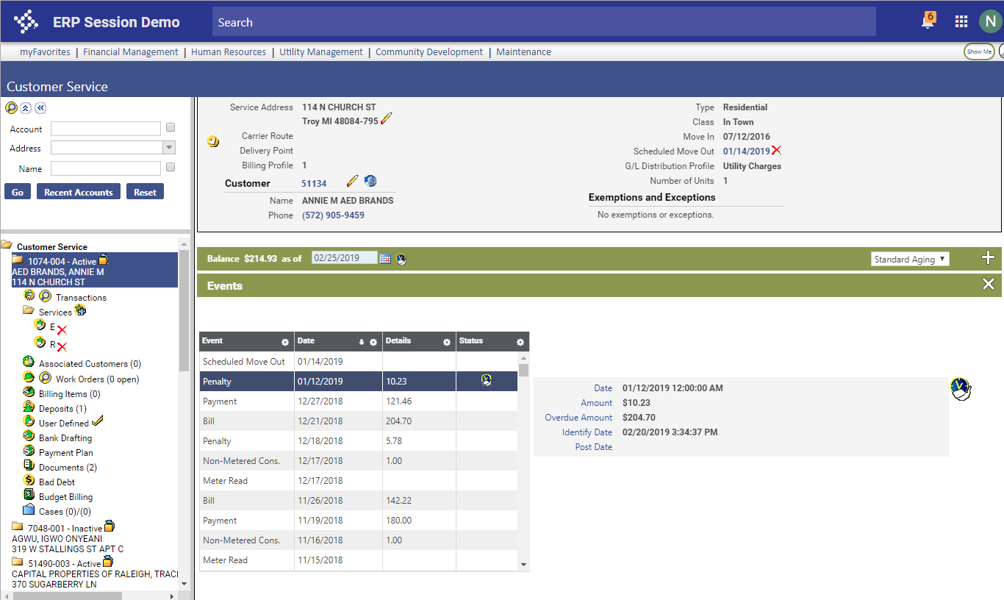

Notes:
Two Parts
Part two, exposing the delinquent event time, when exactly were delinquents processed (any delinquent, notices, penalties, shut off, etc.)
Events
For penalties and other types of delinquents

Slide 29
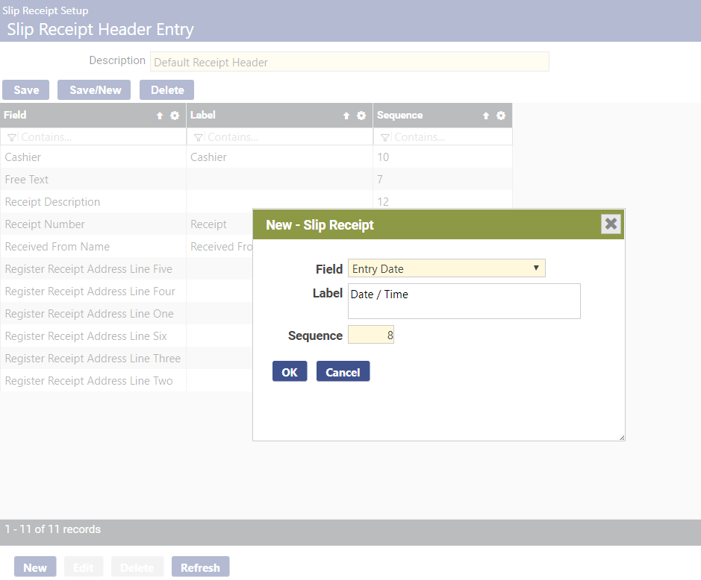
Notes:
Set up in Slip Receipt Header entry
Maintenance > Revenue Collections > Slip Receipt Setup > Header

Slide 30
Add Identifying Data to Bad Debt Export
From the Idea Portal…
Allow Date of Birth and SSN to be exported in Bad Debt File
Collection agencies have a hard time collecting with at least the Social Security Number and Date Of Birth. However, these fields are not available in the export. We understand that the SSN is sensitive information and that there should be internal procedures to prevent unauthorized access. Please add them to the export.
Notes:
Bad Debt Export
It was a highly voted idea
Read Idea content
If turning over to a 3rd party for collection, they typically want this information

Slide 31
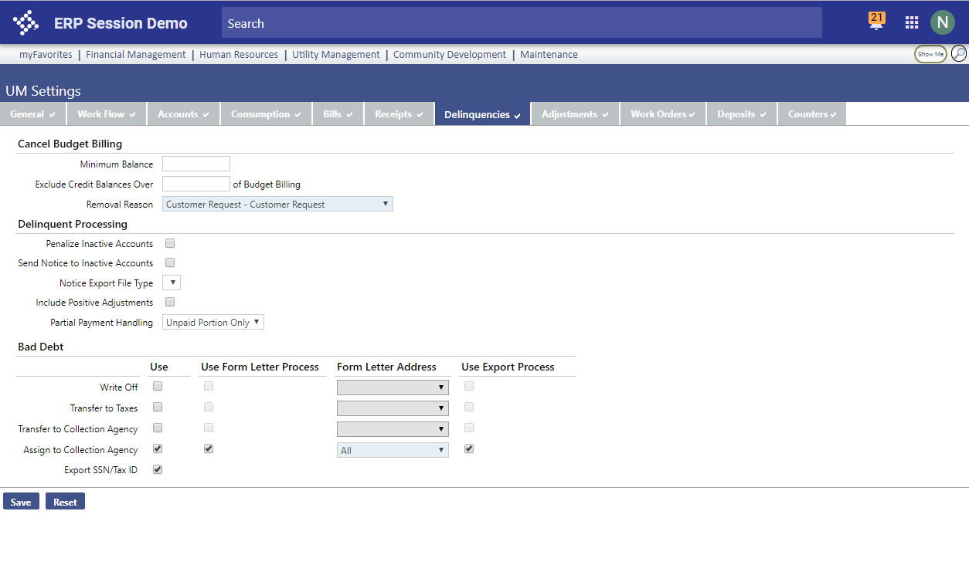

Notes:
Two Parts, part one
Configurable – Sensitive Data – configure on and off

Slide 32
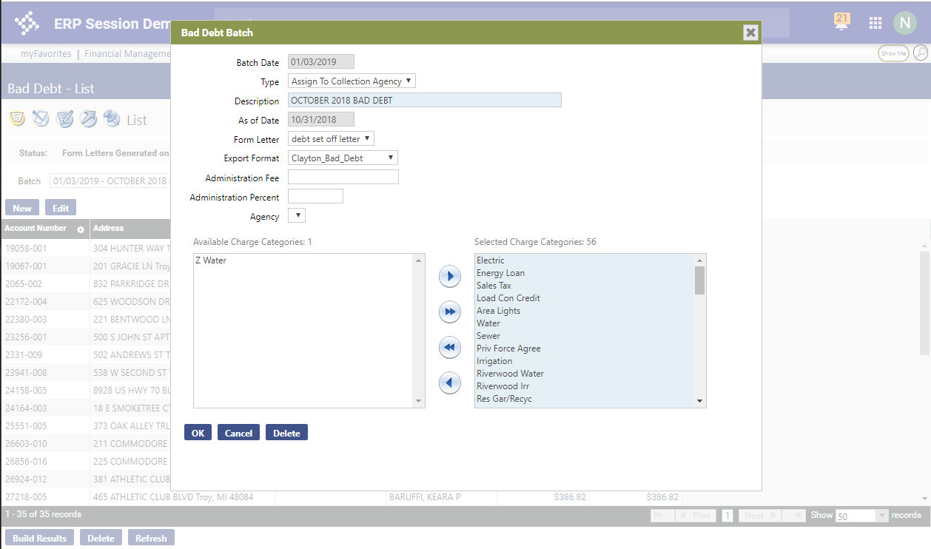
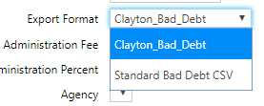
Notes:
Part two,
New standard export
Or customize our existing export

Slide 33
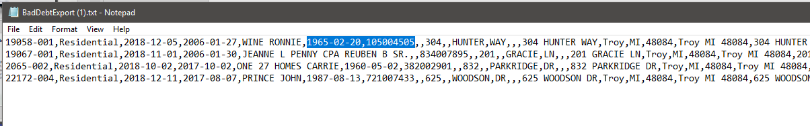

Bad Debt Export
Notes:
Here they are in the data

Slide 34
Identify Pending Move Out in Delinquents
From the Idea Portal…
Delinquent Processing: need to add an exception icon to the Maintain grid that will show an account that is in MOVE OUT status.
When we use delinquent processing to find accounts that are delinquent and will be shut off soon so we can hang a door tag, it'd be nice to see at a glance if this account is in move-out status.
Notes:
Delinquent Processing
It was a highly voted idea

Slide 35
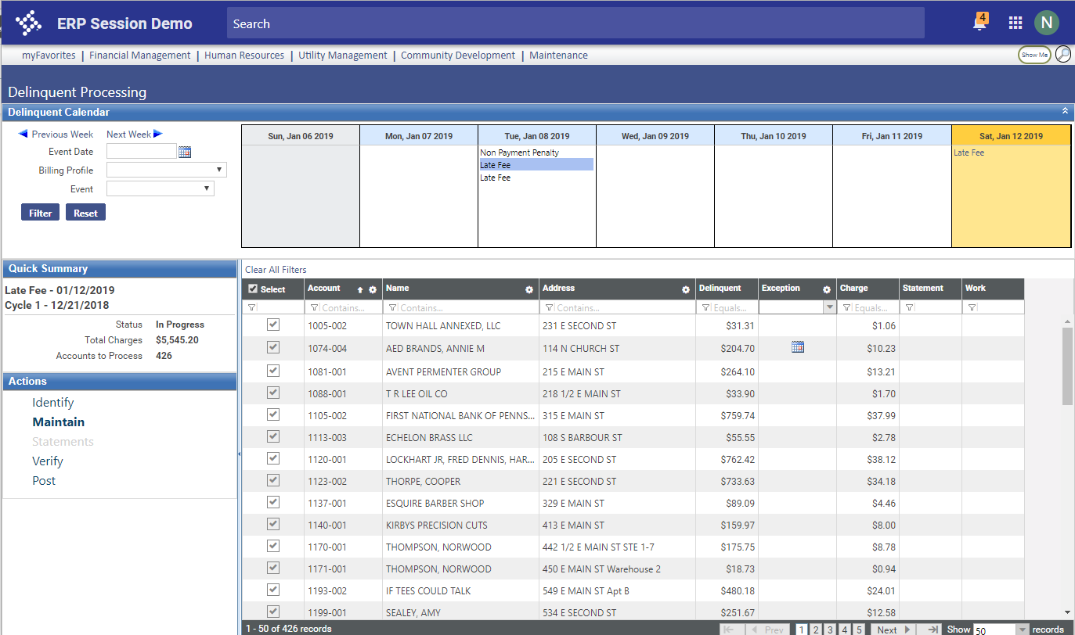

Notes:
Delinquent Processing
Icon in the exceptions column to call out accounts scheduled for move out.
Fully searchable in the filter at the top of the grid.

Slide 36
Your Notes and Notes of Others
’Internal’ Item
Global search should return all notes, not just yours
This will help you find recent calls even if they were not yours.
Notes:
Earlier we talked about using global search to search for notes. Find accounts by notes you entered
It used to search for your notes only
Now it searches for anyone's notes.
‘Hand off’ or research someone else's work

Slide 37
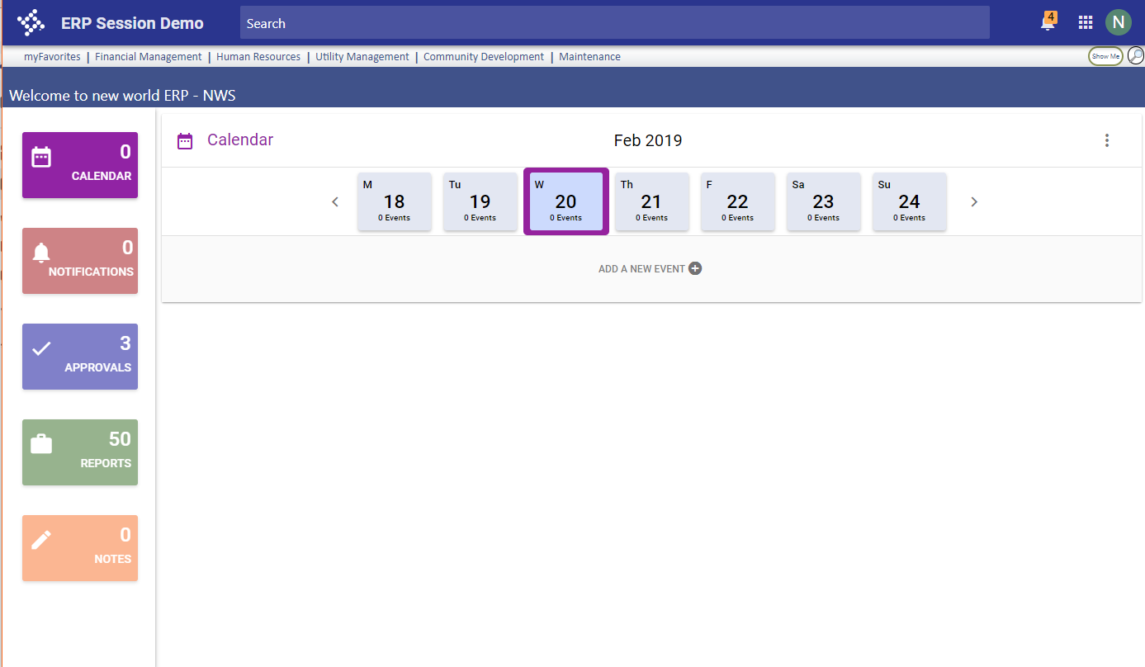
Notes:
2018.1 added the global search option – its on every page
Search for a word or phase I entered in a note documenting a call

Slide 38
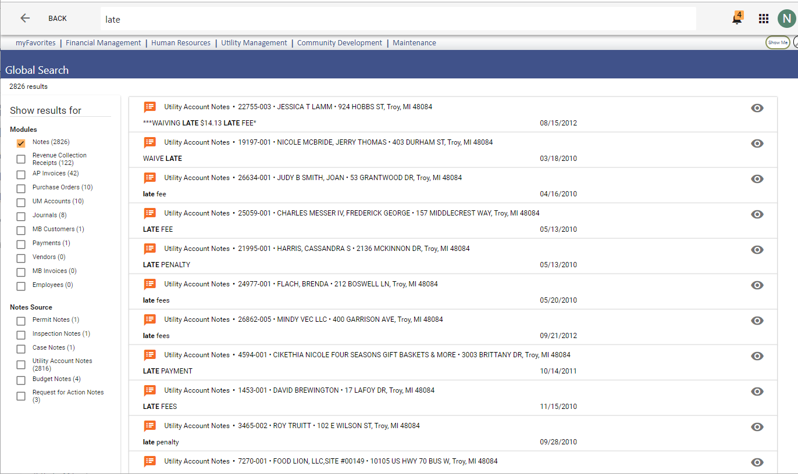


Notes:
It searches results throughout all of NWERP
Has filters like Amazon
Click the ‘Notes’ button to subset to notes
See just notes.
Can drive to customer service using the eyeball at the right.

Slide 39
Using Credit Cards at the Window
’Internal’ Item
Support for OpenEdge in Integrated Credit Card Processing
An additional payment provider supported for point of sale Integrated Credit Card processing.
Notes:
Credit card processing. Subsequent slides explain

Slide 40

Using credit cards at the window
Supported payment providers
Authorize.Net (sunsetting)
Bridgepay
Openedge (New)
Notes:
We support 2 payment providers

Slide 41
Using credit cards at the window
OpenEdge support for
eSuite payments (existing)
Recurring credit cards (existing)
POS / Integrated credit cards (new)
Notes:
We do credit card processing in 3 places
One of those is receipts / POS (Point of Sale). We offer a fully integrated option.
We added this 3rd item for openedge
OpenEdge is now on par with Bridgepay, supporting all three of these features
Authorize only supports the top 2

Slide 42
Transfer credit balance to the new account
From the Idea Portal (actually from What’s New session at 2018 Connect)
Be able to transfer a credit balance form one account to another
Notes:
From the idea portal

Slide 43
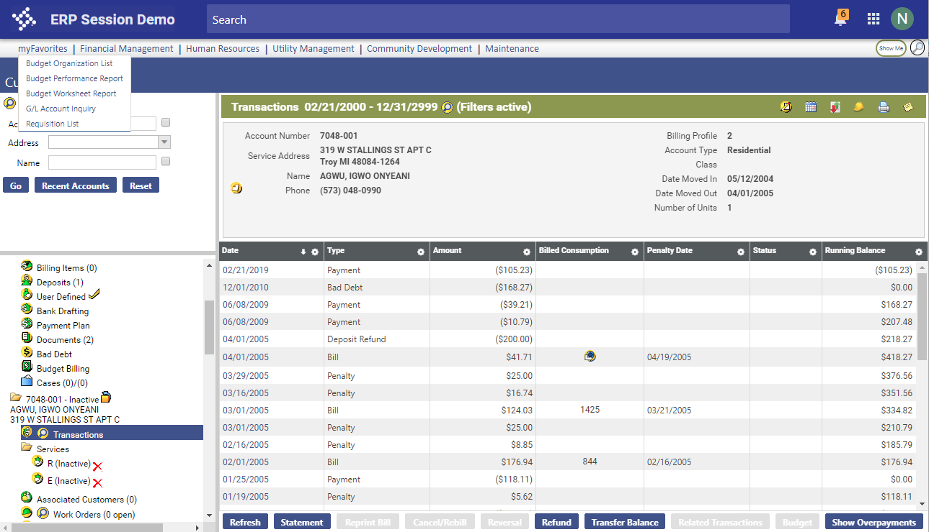

Notes:
Transfer credit balances
For a while now we have allowed you to transfer a positive balance
move money a customer owes from their old account to their new account, easier to collect
Now we allow movement of credits
typically when they pay their old account. Get that payment onto their new account
Credit Balance on an inactive account – Transfer button available.

Slide 44
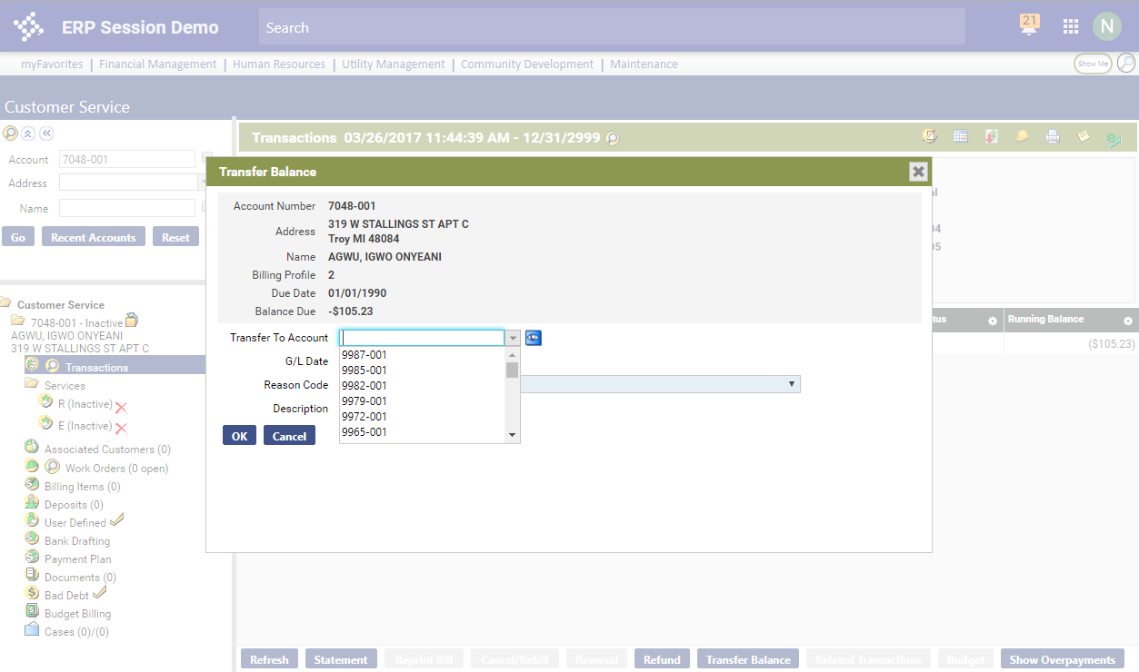
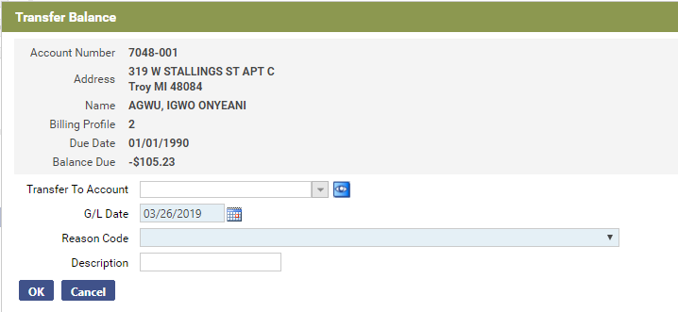
Notes:
Same process as before. Just opened up for credits
This creates an adjustment (actually a compound adjustment effecting 2 accounts)

Slide 45
Charitable Contributions – “round up”
From the Idea Portal…
Billing Charitable Contributions via rounding bills
We have a "neighbors helping neighbors" program and can currently bill a fixed amount as a charitable contribution ($1/month, etc.) Our old software allowed us to ROUND UP the balance of the utility bill where the change would be billed to a charitable contribution line item. We would like to see this Round Up added in NWS.
Notes:
Charitable Contributions
You can charitable contributions now in the system with a basic work around
enrollment based
fixed contribution amount
We formalized support for them
We added support ‘round up’ contribution amount

Slide 46
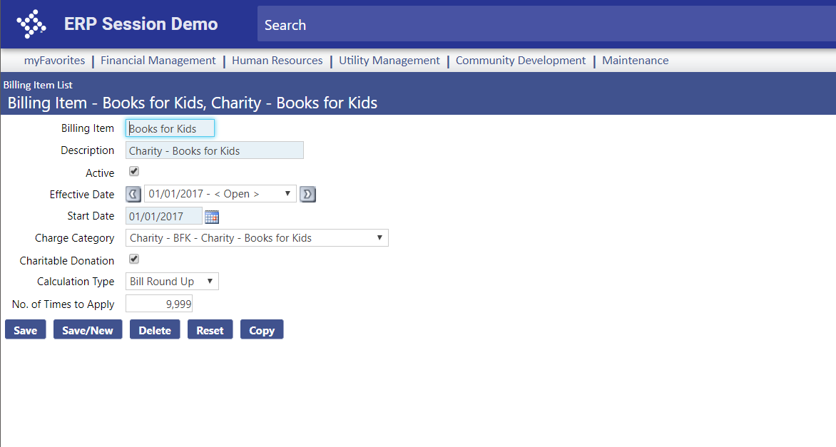
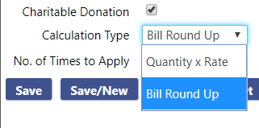
Notes:
Core change is here setting them up
is it a charity
is it a traditional calculation, or rounding the bill up

Slide 47
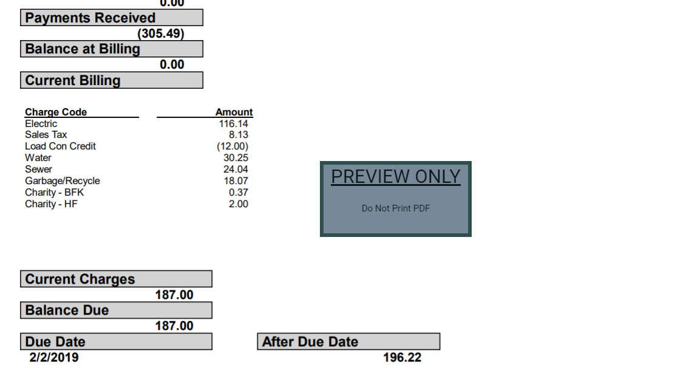


Charitable Contributions – “Round Up”
Notes:
Assign the billing item to a customer to enroll them in the charity.
It then bills out automatically
point the billing items at their own charge category - they will appears as their own line items on the bill
those charge categories point to specific GLs to track this money
Payments automatically allocated when they come in

Slide 48
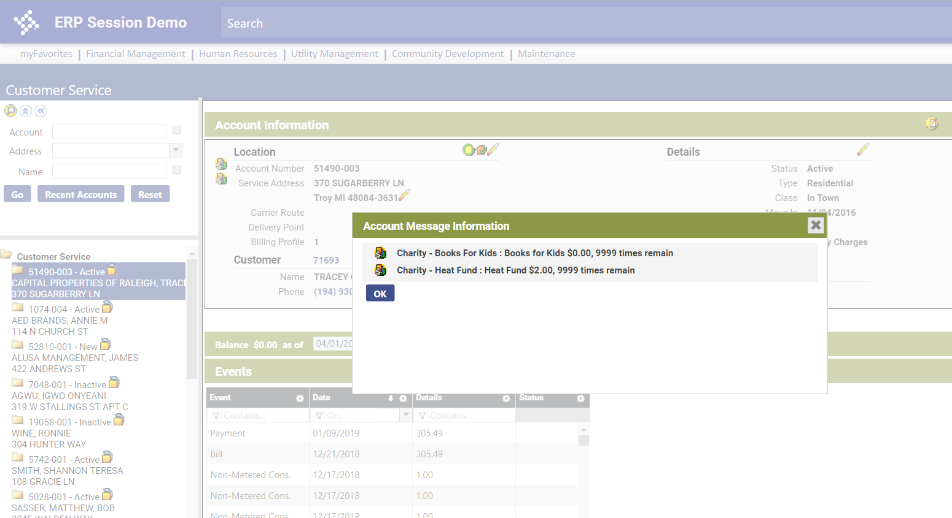

Notes:
One improvement is visibility.
The only visibility that an account is on a charity is the count in billing items attribute
But that could be other types of billing items
We fixed the billing items account messages. Now you can configure a message to appear based on the existence of charitable billing items

Slide 49

Charitable Contributions
  Final bills – charity items charged only one more time
Notes:
Another big improvement to the old work around for charity.
In the work around, you would need to intervene at finals time so they charity would only be charged out on last time rather than charged a huge charge (9999 times to apply)
Now if the billing item marked as charity, it will only be charged one last time at finals.
There is a document for all of this, and there will likely be webinars of video material

Slide 50

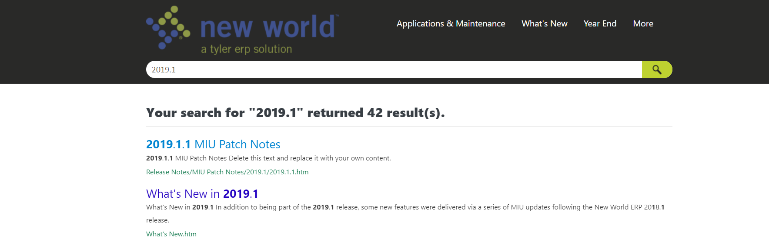
Resources
Search Help Central!
2018.1 update
2019.1

Slide 51
Questions?

